Slide 1

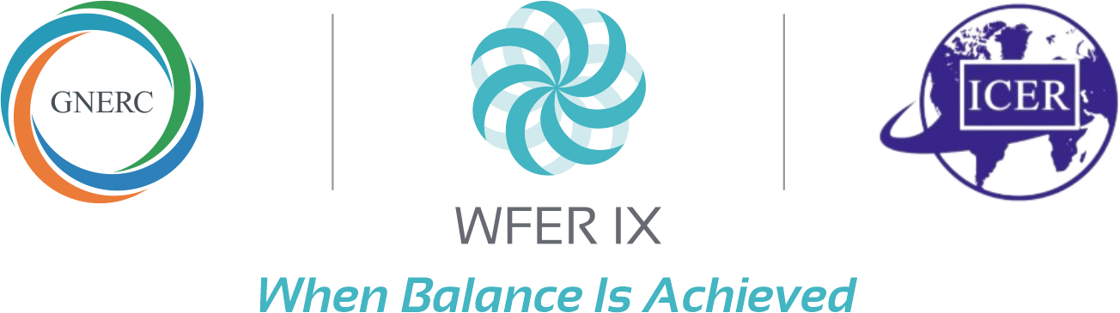

Cybersecurity and Resilience in Energy Infrastructure
Jim Robb, President and CEO,
North American Electric Reliability Corporation
(NERC)
Session 5c 24/September/2026

Slide 2
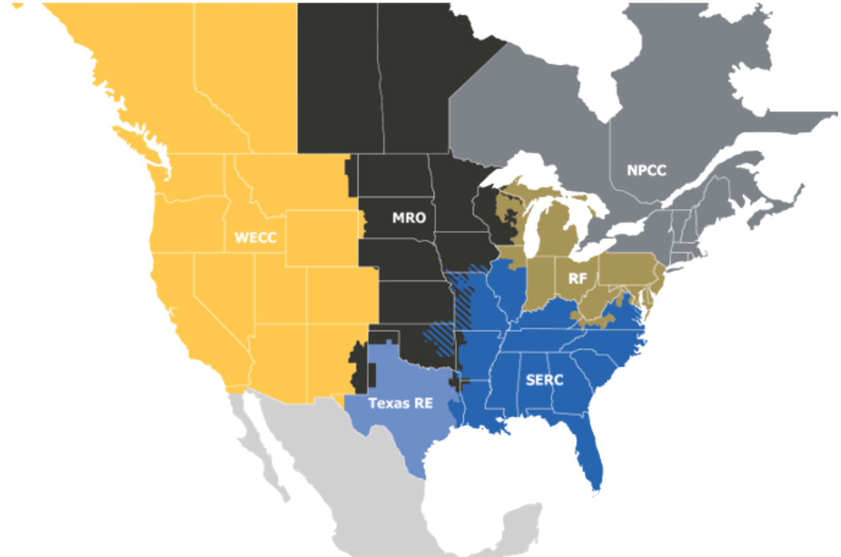
The ERO Enterprise
The vision for the Electric Reliability Organization (ERO), which is comprised of NERC and the six Regional Entities, is a highly reliable and secure North American bulk power system (BPS).
As the ERO, we are accountable to regulators in the United States (Federal Energy Regulatory Commission) and Canada (Canada Energy Regulator and provincial governments).

Slide 3
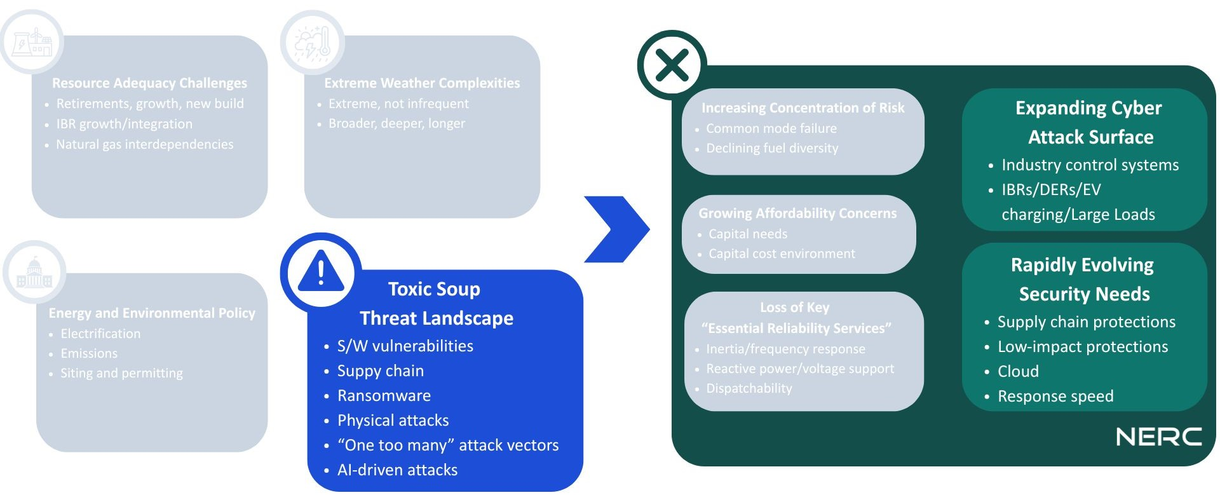
Hyper-Complex Risk Environment

Slide 4
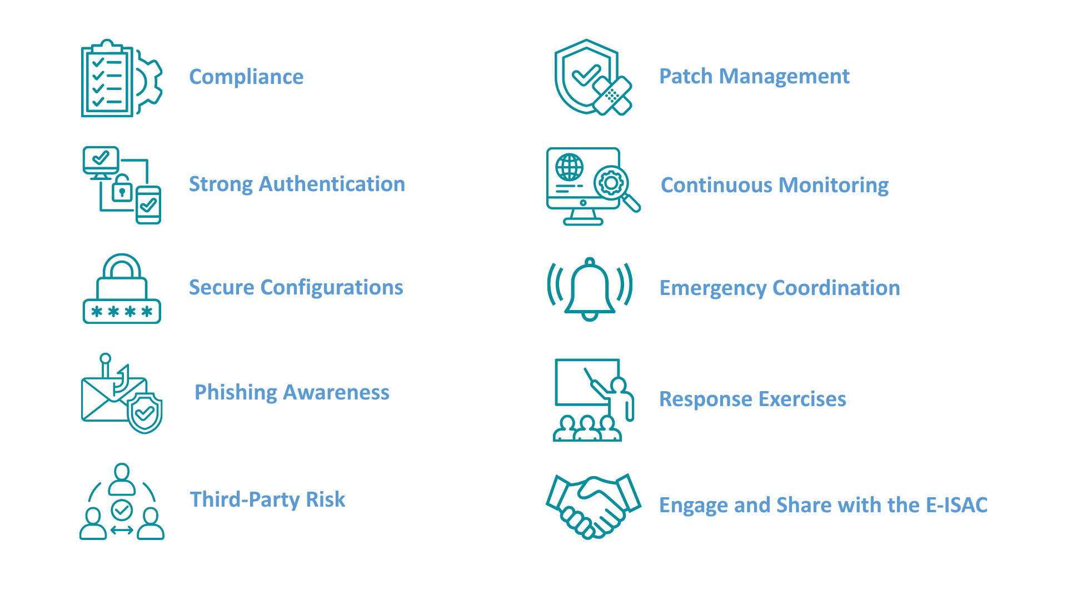
Top 10 Security Actions

Slide 5
Cybersecurity and Resilience
Session 5c - Cybersecurity and Resilience in Energy Infrastructure

